Slide 1
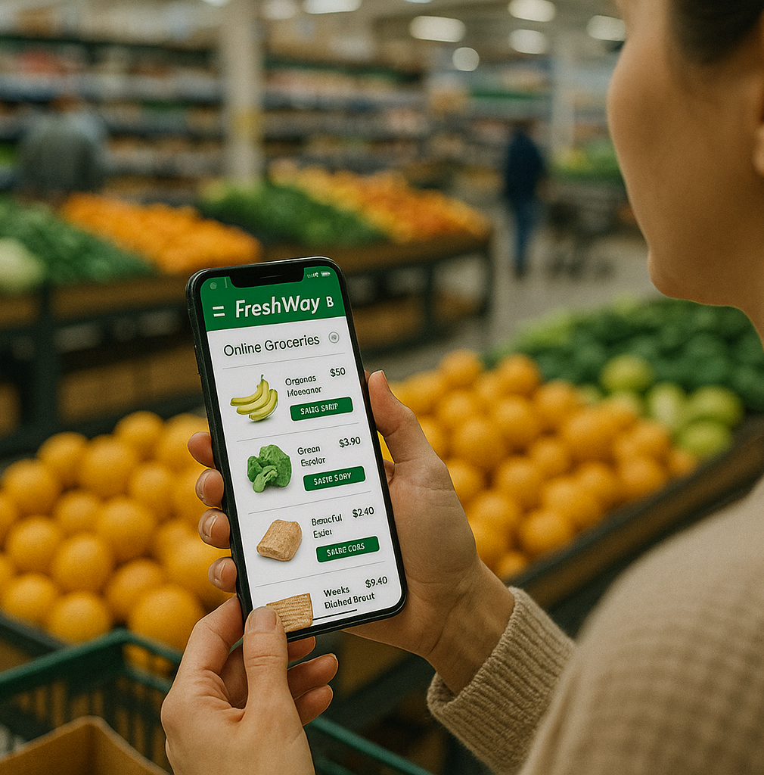
Smart logistics
Lesson 4 – Digital Developments
Minor SCE

Slide 2
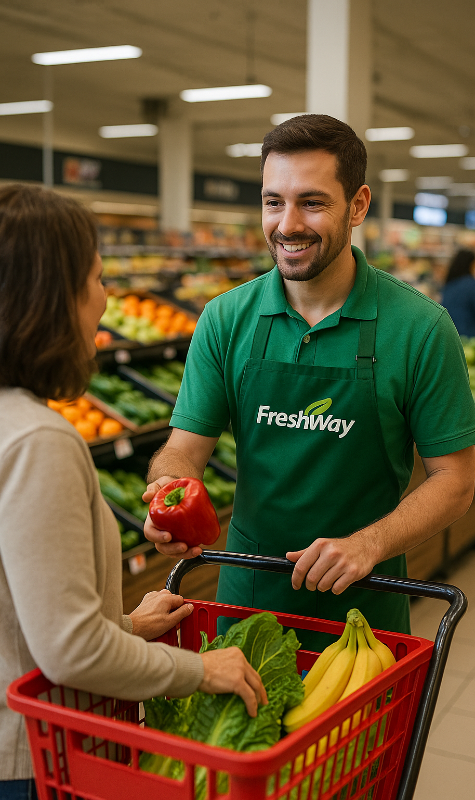
Course Overview
Smart logistics
1 Introduction and company start-up
2 Smart logistics and business intelligence
3 Data driven logistics
4 Digital developments
5 AI and GenAI in logistics
6 Self organising logistics
7 Sensors and smart supply chains
8 Consolidation and alignment
9 To be announced
Notes:
Standardised nine-topic list, canonical English wording from the lesson-concept document (Sept 2026).
If the nine-lesson concept is not adopted, delete this slide and keep the old one.

Slide 3
Today
Lesson 4
08:45
20′
Board opening: commitments, Board Memos and your data models
09:05
50′
Masterclass: digital developments
09:55
10′
Break
10:05
35′
The five bodies: Technology Register, architecture check
10:40
30′
Department work: choose your developments
11:10
5′
Board close: your commitment for lesson 5
Notes:
08:45 · agenda, 30 seconden
Loop de agenda kort door. Zelfde standaardritme van 150 minuten als in les 3: Board opening met doorloop van de toezeggingen 20, masterclass 50, pauze 10, de vijf organen gelijktijdig 35, afdelingswerk 30, Board close 5. Oranje is het blok aan de eigen tafel.
De masterclass: technologische ontwikkelingen, Logistics-as-a-Service, interoperabiliteit en federated learning (dia Program of today). De lespagina belooft ook dat de docent de regelgevingstijdlijn doorloopt (Data Act, eFTI, AI Act, Cyberbeveiligingswet). Die dia's staan in het deck van les 3, niet in dit deck.

Slide 4

Smart warehousing & production logistics
Smart Logistics
New technologies and innovations:
New technologies offer the opportunity to make our logistics smarter
That not only leads to lower costs, but also to faster and more flexible processes
Smart logistics is about the smart organization of our (production) logistics processes

Slide 5
Board opening and commitments
Lesson 4 · Board opening
Frits Coers
CEO Operations & Technology
1 The Board walks through the Decision Log. You may correct us.
2 Each manager on the lesson 3 commitment: met · not met and why · adjusted in advance
Wilbur Hage
CEO Finance & Logistics
3 Your Board Memos, and feedback on your data models. One department presents.
Adjusting in advance costs nothing. Staying silent is the only real failure.
Notes:
08:45 · 20 min · beide docenten
Volgorde: (1) de Board loopt de Board Decision Log door; studenten mogen ons corrigeren. (2) Elke Department Manager beantwoordt de toezegging uit les 3: gehaald, niet gehaald en waarom, of vooraf bijgesteld. Vraag daarbij of de twee Interface Agreements door de ontvangende afdeling zijn bevestigd (lespagina: 'confirm the Interface Agreement you received'). Het antwoord gaat in de MT-notulen. (3) De Board Memo's uit les 3 en de algemene feedback op de zeven datamodellen (SA2). Daarna presenteert één afdeling haar model: dia's Presentation time en Feedback. Drie terugkerende punten volgens de lespagina: verspreide architectuur, ontbrekend proces, losse einden.
Vanaf deze les is de Non-Delivery Notice realistisch in beeld: heeft een afdeling een afgesproken levering niet gedaan, dan wijst de notice naar de gedateerde regel in de MT-notulen van les 3.
De vier regels die het formatief houden: vooraf bijstellen kost niets en wordt genoteerd, niet aangerekend; zwijgen is het enige echte verzuim; een gemiste toezegging die een ander raakt, kan een Non-Delivery Notice opleveren; twee gemiste toezeggingen zonder bijstelling zijn een aanleiding voor de scopeverkleining in les 6. Geen cijfer tijdens de rit.

Slide 6

Presentation time
Storage: Present your data model

Slide 7
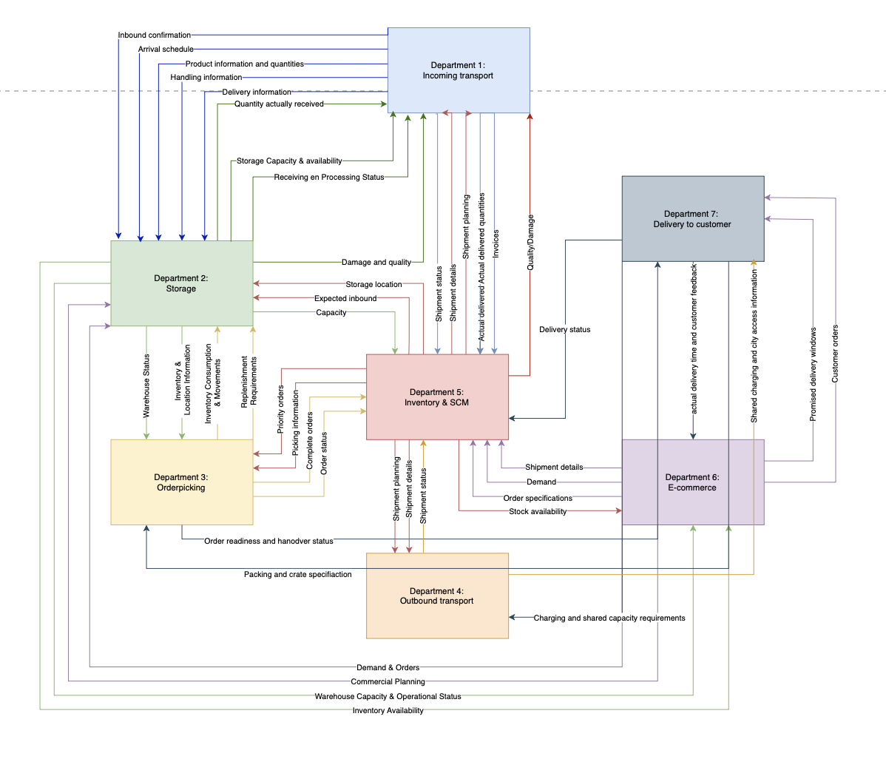

Slide 8
Feedback Data Flow Diagrams
Feedback
A lot of connections between departments
Cool visuals!
Next steps:
  Add events
  Some lines are missing (E-commerce -> storage)
  Check if all the data is available
  Add digital developments

Slide 9
Feedback Data Flow Diagrams
Feedback
2 groups did not hand in their DFD’s! (E-commerce, 2nd strike!)
Some groups didn’t put all the required information in
  Names of group members
  AI declaration

Slide 10


Slide 11
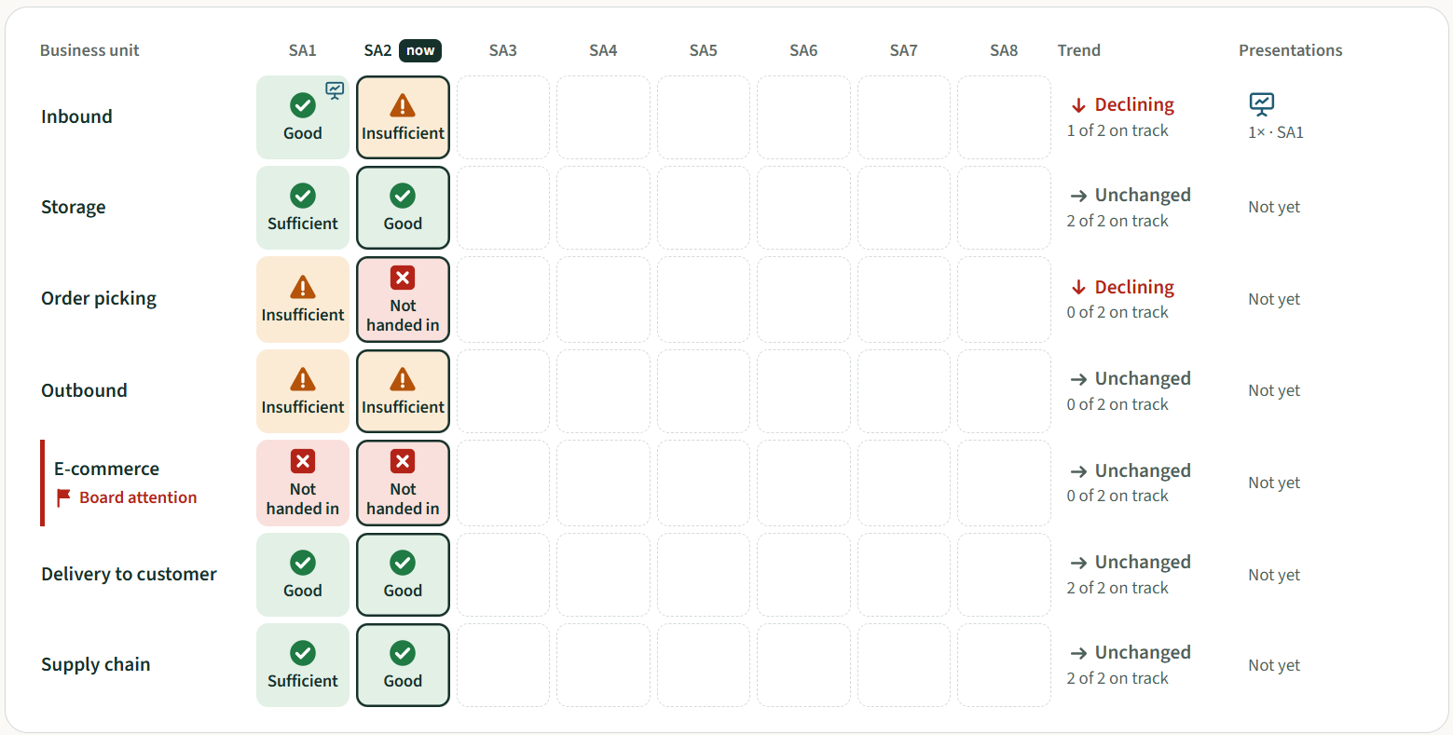

Slide 12
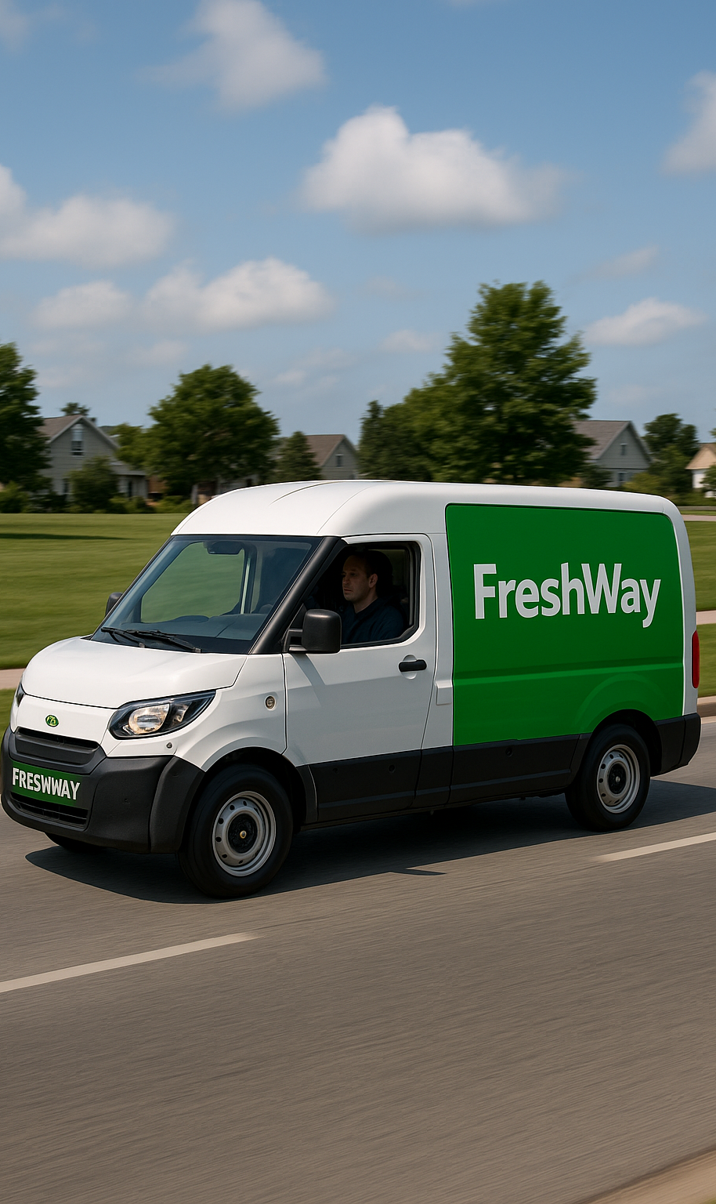
Program of today
Smart Logistics
Technological developments in logistics
Logistics-as-a-Service
Interoperability
Federated learning

Slide 13
Technological developments

Slide 14
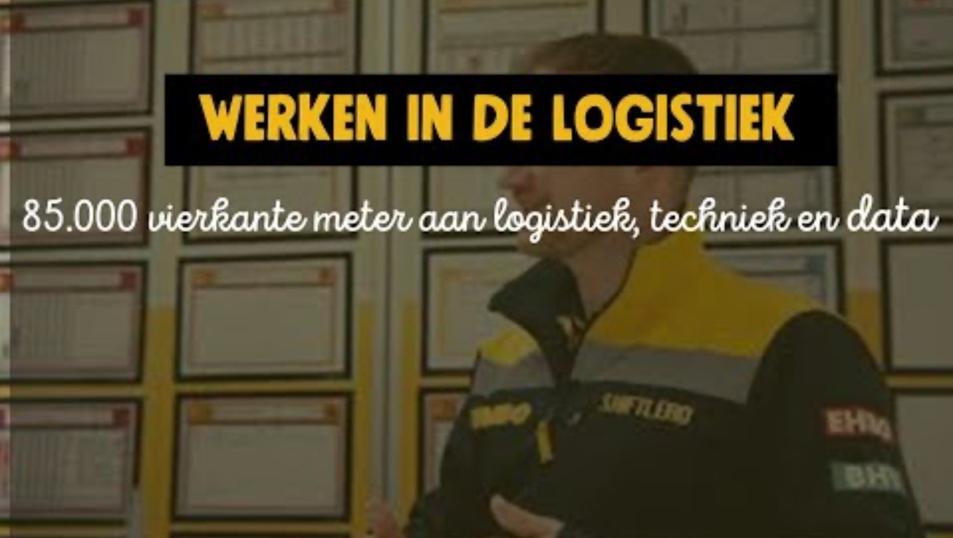

Slide 15

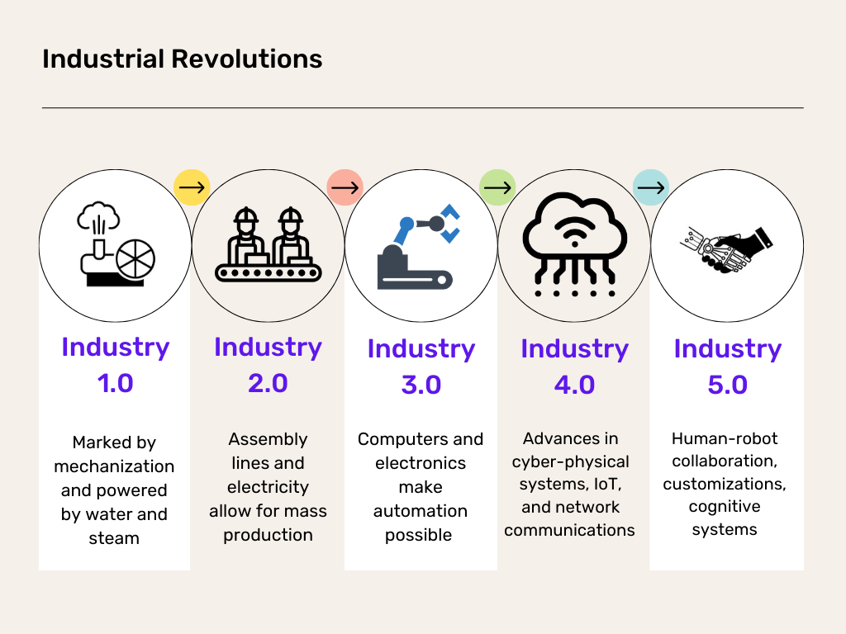
Smart, smarter, smartest
Smart Logistics
Notes:
Amazon is at the forefront of smart logistics, but there are other parties that are going even further with AI and Machine learning fully integrated

Slide 16
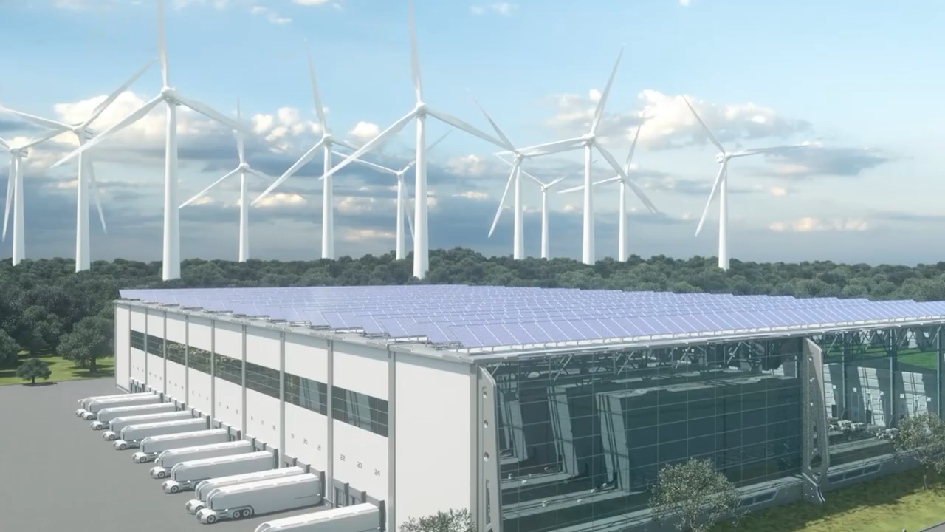

Slide 17
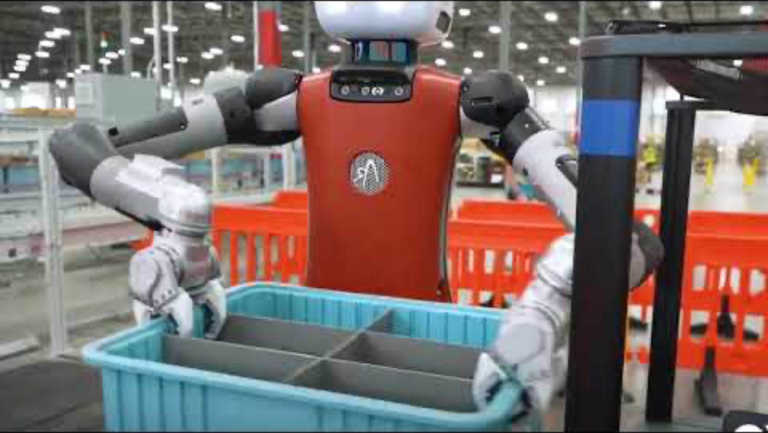

Slide 18
Increasing digital autonomy in logistics
Smart logistics
Until now AGV’s and AMR with limited autonomy
In the coming years implementation of AI enabled autonomy
AMR’s
  No fixed routes · Higher speeds · More flexible
Humanoid robots
  Robots working in an environment designed for humans
  Maturity (2026): pilots and demonstrations, not deployed logistics technology.
Swarm learning
Notes:
Change: maturity label added to humanoid robots. Source: Onno, research block A1 §3.7. Recheck: mid-2027.
Without the label a group can put a technology in a business case that cannot be bought. Same failure mode as LoadRunner in Lesson 6 and Blue Jay.

Slide 19
Logistics as a service

Slide 20
Logistics-as-a-Service (LaaS)
Smart logistics
On-demand logistics services via cloud-based platforms. Retailers scale fulfilment without owning infrastructure.
Examples
  Oda Systems — Oda spun its logistics platform out as a product in 2025 and sells it to other grocers; Swedish online grocer Mathem was migrated onto it within months. That is the LaaS definition, in a supermarket.
  Bleckmann — Bscale — modular plug-and-play warehousing and fulfilment, now in the UK and the Netherlands. Logistics capability bought as a service rather than built.
  Amazon Buy with Prime — US only. The EU equivalent is Multi-Channel Fulfillment (German site since 8 Mar 2026). Since 2 May 2026 Amazon charges a 3.5% fuel and logistics surcharge: “as a service” does not mean a fixed price.
  FedEx + Microsoft (2020) — still running, but six years old. Fresher: FedEx Dataworks with ServiceNow (2026).
Notes:
Change: all four captions rewritten. Source: Onno, research block A1 §3.1-3.4. Recheck: mid-2027.
Oda and Bleckmann are not corrections but upgrades: the same example with a sharper story. Oda is a supermarket, so it transfers straight to FreshWay.
MANUAL ACTION: the old slide holds an embedded Bleckmann video that could not be copied automatically. Either keep the old slide for the video (delete only its OLD banner) or re-insert the video here yourself.

Slide 21
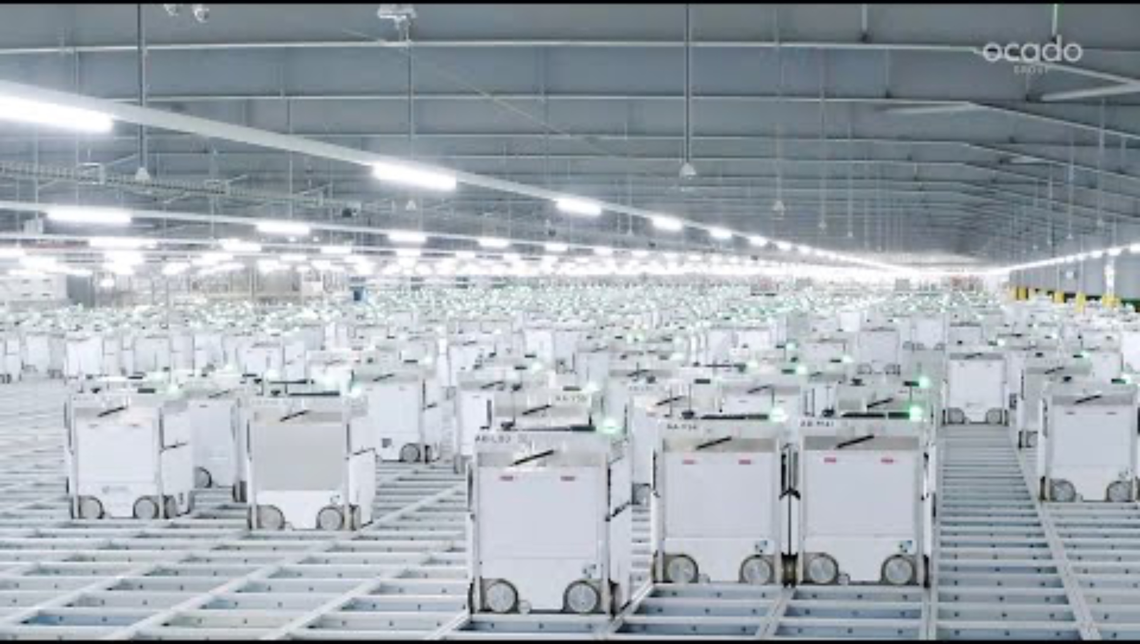
Example

Slide 22
Interoperability

Slide 23
Interoperability
Smart logistics
Different systems and partners share data seamlessly.
Open standards (e.g. electronic CMR, eFTI) and data spaces (e.g. iSHARE) build trust.
  eFTI — Regulation (EU) 2020/1056: from 9 July 2027 authorities in every Member State must accept freight information shared electronically through certified platforms. For business it is a right, not an obligation — paper stays valid.
Example
  Shared control towers linking carriers, warehouses and e-commerce platforms.
Bottleneck is companies not willing to share their data.
  The EU removes the legal barrier. The commercial one stays. That is why TradeLens closed in 2023 with working technology.
Notes:
Change: eFTI added, with the corrected date. Source: Onno, research block A3 §3.4. Recheck: mid-2027.
IMPORTANT: the acceptance duty for authorities starts 9 July 2027, not 21 August 2026. The earlier date in the research plan was withdrawn by Onno himself.
The existing line 'bottleneck is companies not willing to share their data' does not weaken — it gets stronger. Links to TradeLens in Lesson 7 and to the Data Act in Lesson 3.

Slide 24
Data spaces: still being built
Read the numbers carefully
A data space is a set of agreements that lets organisations share data without losing control over it. It exists because the barrier is not technology but trust.
In the Netherlands: the Digitale Infrastructuur Logistiek programme (2022-2027, EUR 51.1m from the National Growth Fund) is building the Basis Data Infrastructuur on the Dutch iSHARE trust framework. Living labs at the Port of Rotterdam and Schiphol.
Figures such as “1,750 SMEs” and “80% of Rotterdam container volume” are targets for 2027 — published as intended results, not results achieved.
In Europe: Catena-X (automotive) is the most mature industrial data space — yet a EUR 23m accelerator was launched in 2026 precisely because SMEs still lack access.
The question to ask: who is exchanging data today, in what volume, since when? Ambition is not adoption.
Notes:
New slide, no predecessor. Source: Onno, research block B2. Recheck: mid-2027.
This makes the abstract interoperability lesson Dutch and concrete. The teaching point is the difference between a programme target and a measured result — students quote the first as if it were the second.
Sources: Nationaal Groeifonds; datainlogistics.org; Catena-X/IDSA (2026); Forrester on Gaia-X.

Slide 25
Federated learning

Slide 26
Federated Learning
Collaborative AI training without sharing raw data.
Supports joint demand forecasting, route optimization, risk prediction.
Enables privacy-preserving insights across competing retailers or carriers.

Slide 27

Federated learning steps 1/5
We start by initializing the model on the server.
This is exactly the same in classic centralized learning: we initialize the model parameters, either randomly or from a previously saved checkpoint.

Slide 28
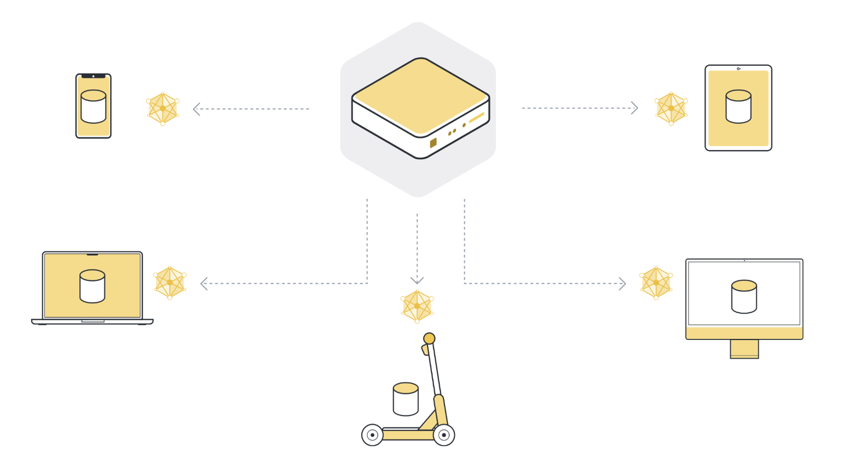
Federated learning steps 2/5
Next, we send the parameters of the global model to the connected client nodes (think: edge devices like smartphones or servers belonging to organizations).
This is to ensure that each participating node starts its local training using the same model parameters.

Slide 29
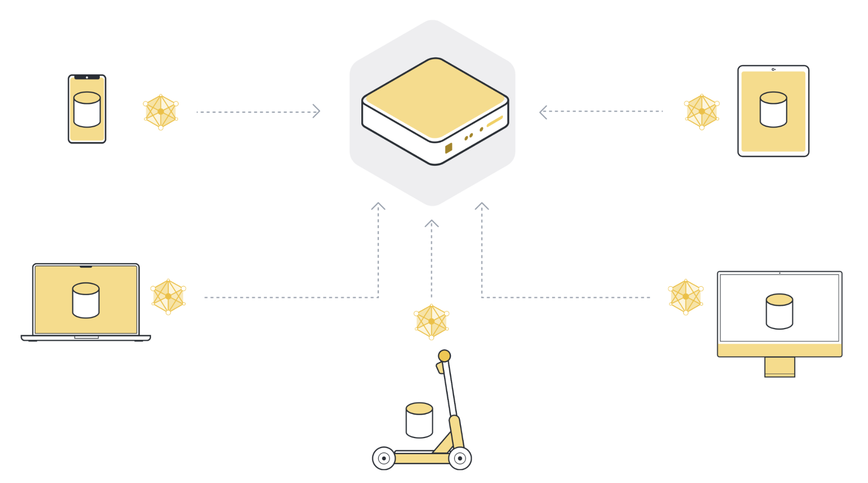
Federated learning steps 3/5
After local training, each client node has a slightly different version of the model parameters they originally received.
The parameters are all different because each client node has different examples in its local dataset.
The client nodes then send those model updates back to the server.

Slide 30

Federated learning steps 4/5
The server receives model updates from the selected client nodes. If it selected 100 client nodes, it now has 100 slightly different versions of the original global model, each trained on the local data of one client.
In order to get one single model, we have to combine all the model updates we received from the client nodes.

Slide 31
Federated learning steps 5/5
Repeat

Slide 32
Where federated learning actually runs
A yearly test
In production: healthcare, banking and mobile devices — with service levels and audits.
In logistics: still simulation and pilot.
  The most-cited study — a pan-European network of 1,000 trucks, accuracy within 5-8% of a central model, over 99% less data transmitted — is an explicitly simulated deployment.
The concept is proven. The sector has not adopted it.
That makes it a better assignment, not a weaker one: argue why a sector with an obvious data-sharing problem has not picked up the technique built for exactly that problem.
Notes:
New slide, no predecessor. Source: Onno, research block B4. Recheck: annually.
Place this right after the five-step explanation so students leave with the mechanism AND its maturity.

Slide 33
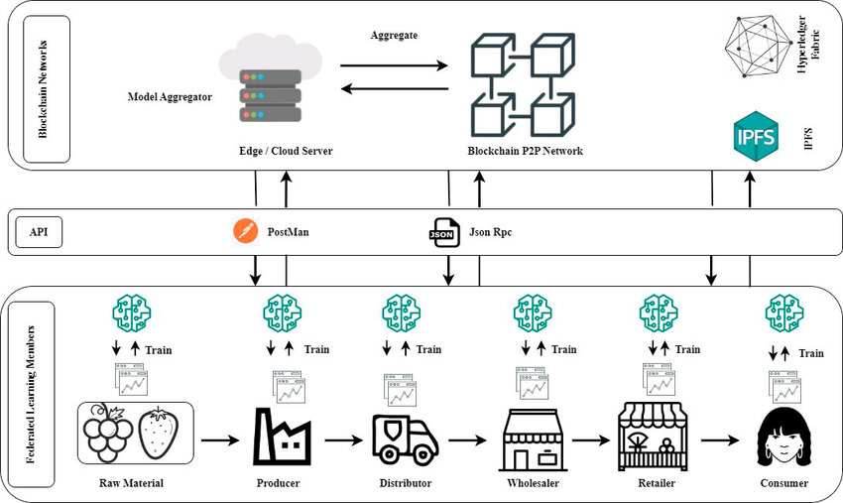

Slide 34
Future developments

Slide 35
Future Outlook
Smart logistics
LaaS becoming mainstream for scalable e-commerce fulfilment.
Interoperability driven by EU data spaces and open APIs for end-to-end visibility — with the legal deadlines now on the timeline (eFTI 2027, Data Act 2026-2027).
Federated learning: still simulation and pilot in logistics after a year of testing the claim. In production in healthcare, banking and mobile devices.
Notes:
Change: the line 'Federated Learning pilots expected to scale' was tested after a year and adjusted. Source: Onno, research block B4. Recheck: annually.
The last bullet is the didactic point: a forecast that is repeated unchecked becomes a claim.

Slide 36
Challenges & risks

Slide 37
Digital foundation not in order
evofenedex, 2025 · n ≈ 300
Dutch trade and logistics companies: 60% are reasonably to very interested in AI — but only 7% have a concrete AI policy.
Only 42% have their internal data largely in order; for a third it is limited.
The same study warns against AI-washing: presenting every new application as smart and intelligent while its added value is limited.
Industry survey, about 300 professionals — not national statistics. Source: evofenedex, Onderzoek AI in handel en logistiek 2025.
Notes:
Change: the figure is dated and labelled as an industry survey, and two stronger figures from the same publication are added (7% with an AI policy; the AI-washing warning). Source: Onno, research block A1 §1.4. Recheck: autumn 2026 for a new edition — Onno checked, there is no 2026 edition yet.
AI-washing here and Gartner's 'agent washing' in Lesson 5 are two independent sources saying the same thing. That is a pattern, not an opinion — and it is exactly what rubric criterion 1 rewards.
NOT COPIED: nothing; the old slide was text plus the layout image.

Slide 38
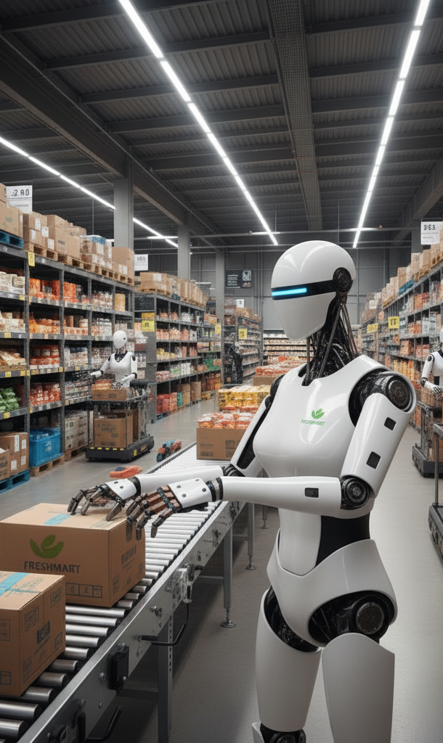
Recap
The basic technologies have matured and getting cheaper, so also available for SME’s
The next step is more collaboration in the supply chain using data exchange and federated learning
New technologies will be adopted by the large companies first because of large investments

Slide 39

Next sub-assignment - 1
Portfolio
Architecture Board Meeting
Look at the data flow diagram and make sure to align with the other teams to ensure one integral architecture model
So Freshway has 1 ERP, 1 WMS etc.
Every team assigns one representative to join the ABM.
The other team members can function as back-up or already start with assignment 2

Slide 40
Next sub-assignment - 2
Portfolio
Research the opportunities regarding digital developments for your part of the company (using credible sources)
Describe the developments and their application for FreshWay
Add the additional processes and apps of the developments in your data flow diagram
Describe how the technology is implemented and used
Which KPI’s are affected?

Slide 41
Next sub-assignment
Portfolio
Hand in your document next Monday at the latest
In the next lesson we give general feedback in class
This will give you an indication if you are on the right track
Prepare a presentation of max 3 slides for the next lesson
One group will be randomly selected to present next lesson
(if you don’t have to present you can use the presentation for the end assessment)

Slide 42
Technology Register and architecture check
The five bodies · 35 minutes, all at the same time
In the Technology Council
In the MT
1
Each department enters two developments
Delivered · needed · blocked
Commitments · mandate files
Finished? Listen in at a council
2
Per entry: source, date, demo · pilot · production
3
Architecture check: one ERP, one WMS, one TMS
Data Council
Investment Council
Communication Council
Confirm the agreements you received. New SA3 flows need one too
Per development: who pays, and where does the benefit land?
One set of words for the same technology in all seven SA3s
A council that writes nothing down has not met.
Notes:
10:05 · 35 min · alle vijf de organen tegelijk
Technology Council (de hoofdrol deze les): de Technology Officers zetten per afdeling twee ontwikkelingen in het Technology Register (Teams, 02 Registers). Per regel: bron met organisatie en datum, en hoe hard het bewijs is: demo, pilot of in productie. Dat is de vraag 'draait het, of is het aangekondigd?' van de lespagina. De council doet ook de architectuurcheck: FreshWay heeft één ERP, één WMS en één TMS, niet zeven. Dat is wat in 2025 de Architecture Board Meeting was (dia Next sub-assignment - 1).
MT: hetzelfde als elke les. Ronde geleverd · nodig · geblokkeerd, en de zeven toezeggingen in concept in de MT-notulen. Deze les extra (regel 2 op de dia): Incoming transport, Storage en E-commerce zeggen wanneer versie 1 van hun mandaatfile er is (Compliance File, Energy & Capacity File, Customer Promise). De andere vier afdelingen wachten op die grens. Klaar? De manager luistert mee bij een council naar keuze en neemt niet over.
Data Council: de ontvangers bevestigen de Interface Agreements uit les 3, voor zover nog niet gebeurd. Nieuwe stromen die SA3 aan het data flow diagram toevoegt en die een afdelingsgrens over gaan, krijgen ook een afspraak.
[VOORSTEL Dide, niet uit de bronnen] Investment Council: per ontwikkeling in het register alvast de vraag van het Investment Register: wie betaalt, en bij welke afdeling landt de baat? Communication Council: één set woorden voor dezelfde technologie in alle zeven SA3's (standaard, interoperabiliteit, dataspace; demo, pilot, in productie). Pas aan of vervang.

Slide 43
Department work: choose your developments
Back at your own table · 30 minutes
1
Debrief: what did your council settle?
2
Per development: which of your KPIs would it move?
3
Divide SA3: who researches what, by when
4
Your commitment, and whose development you will cite
Your manager takes this to the Board close.
Notes:
10:40 · 30 min · docenten lopen rond
Het enige moment waarop de hele afdeling samen werkt. Vier taken, in deze volgorde. Eerst de debrief: iedereen vertelt in één minuut wat zijn council heeft vastgelegd, de Technology Officer als eerste, want die komt terug met het register en de architectuurcheck. Dan per kandidaat-ontwikkeling de vraag welke KPI uit het eigen afdelingsbestand hij zou bewegen. Dan SA3 verdelen. Als laatste de toezegging, inclusief welke ontwikkeling van een andere afdeling jullie citeren.
Vragen bij het rondlopen, uit de lespagina: wie gebruikt het, sinds wanneer, en hoeveel? Is het in productie, een pilot of een persbericht? Een voorspelling is geen resultaat.

Slide 44
Seven commitments, out loud
Board close · 5 minutes
“[Department] hands in SA3 by Monday, end of day,
with two Register entries and one cited from [dept].”
Recorded in the MT minutes · the Board logs one line
Lesson 5 opens with the check on it, and with your Board Memo
Incoming transport, Storage, E-commerce: also mandate file v1
Managers: hand in your Board Memo before you leave.
Notes:
11:10 · 5 min · beide docenten
Elke manager spreekt de toezegging uit in de vorm van de zin op de dia. De MT-notulen hebben er zeven rijen voor; de Board legt in de Board Decision Log één regel vast: de zeven toezeggingen voor les 5 zijn genoteerd.
Drie managers zeggen er iets bij: Incoming transport, Storage en E-commerce leveren vóór les 5 versie 1 van hun mandaatfile (Compliance File, Energy & Capacity File, Customer Promise). Ruw en met de aannames erin is prima; er niet zijn blokkeert vier afdelingen.
De managers leveren voor ze weggaan hun Board Memo in (één A4 per les). Die komt in de Board opening van les 5 terug, samen met de doorloop van de toezeggingen. Herhaal de afspraak van dia 'Next sub-assignment': SA3 inleveren maandag einde dag; de feedback komt in les 5 algemeen in de les.

Slide 45
Next lesson
Portfolio
Feedback on your research
Presentation of one plan (be prepared!)
Lesson (gen)AI in logistics

Slide 46
GenAI transparency
GenAI
These slides build on the 2025 course materials written by your lecturers. For 2026 the facts, figures and examples were checked and updated with GenAI support, and a number of slides were added.
Human-AI Agency Label: Creative Director — your lecturers set the structure and the line of reasoning; GenAI carried out specific parts within that frame, and every change was checked before it went in.
Labels source: Boetje, J., & Baake, G. (2026). Nine prototypical human-AI agency patterns [Figure]. figshare. https://doi.org/10.6084/m9.figshare.31706884 (CC BY 4.0).
Notes:
Afsluitende dia: de GenAI-verklaring bij dit deck. Kort benoemen dat wij als docenten zelf ook transparant zijn over GenAI-gebruik — hetzelfde als wat wij van jullie vragen bij het portfolio. Niet voorlezen; één zin volstaat.

